Slide 1
Adversary Search
Ref: Chapter 5

Slide 2
Games & A.I.
Easy to measure success
Easy to represent states
Small number of operators
Comparison against humans is possible.
Many games can be modeled very easily, although game playing turns out to be very hard.

Slide 3
2 Player Games
Requires reasoning under uncertainty.
Two general approaches:
  Assume nothing more than the rules of the game are important - reduces to a search problem.
  Try to encode strategies using some type of pattern-directed system (perhaps one that can learn).

Slide 4
Search and Games
Each node in the search tree corresponds to a possible state of the game.
Making a move corresponds to moving from the current state (node) to a child state (node).
Figuring out which child is best is the hard part.
The branching factor is the number of possible moves (children).

Slide 5
Search Tree Size
For most interesting games it is impossible to look at the entire search tree.
Chess:
  branching factor is about 35
  typical match includes about 100 moves.
  Search tree for a complete game: 35¹⁰⁰

Slide 6
Heuristic Search
Must evaluate each choice with less than complete information.
For games we often evaluate the game tree rooted at each choice.
There is a tradeoff between the number of choices analyzed and the accuracy of each analysis.

Slide 7
Game Trees

Slide 8
Plausible Move Generator
Sometimes it is possible to develop a move generator that will (with high probability) generate only those moves worth consideration.
This reduces the branching factor, which means we can spend more time analyzing each of the plausible moves.

Slide 9
Recursive State Evaluation
We want to rank the plausible moves (assign a value to each resulting state).
For each plausible move, we want to know what kind of game states could follow the move (Wins? Loses?).
We can evaluate each plausible move by taking the value of the best of the moves that could follow it.

Slide 10
Assume the adversary is good.
To evaluate an adversary’s move, we should assume they pick a move that is good for them.
To evaluate how good their moves are, we should assume we will do the best we can after their move (and so on…)

Slide 11
Static Evaluation Function
At some point we must stop evaluating states recursively.
At each leaf node we apply a static evaluation function to come up with an estimate of how good the node is from our perspective.
We assume this function is not good enough to directly evaluate each choice, so we instead use it deeper in the tree.

Slide 12
Example evaluation functions
Tic-Tac-Toe: number of rows, columns or diagonals with 2 of our pieces.
Checkers: number of pieces we have - the number of pieces the opponent has.
Chess: weighted sum of pieces:
  king=1000, queen=10, bishop=5, knight=5, ...

Slide 13
Minimax
Depth-first search with limited depth.
Use a static evaluation function for all leaf states.
Assume the opponent will make the best move possible.

Slide 14
Minimax Search Tree
A
Our Move
Maximizing Ply
B
C
D
Opponent’s Move
Minimizing Ply
E
F
G
H
I
J
K
9
-6
0
0
-2
-4
-3

Slide 15
Minimax Algorithm
Minimax(curstate, depth, player):
If (depth==max)
Return static(curstate,player)
generate successor states s[1..n]
If (player==ME)
Return max of Minimax(s[i],depth+1,OPPONENT)
Else
Return min of Minimax(s[i],depth+1,ME)

Slide 16
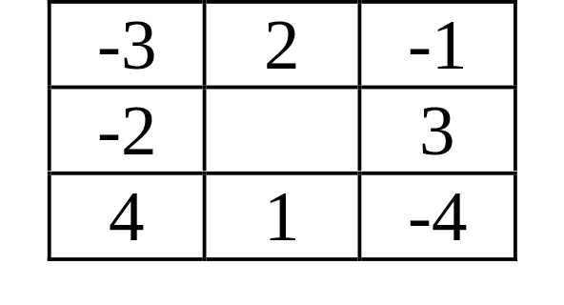
The Game of MinMax
Start in the center square.
Player MAX picks any number in the current row.
Player MIN picks any number in the resulting column.
The game ends when a player cannot move.
MAX wins if the sum of numbers picked is > 0.

Slide 17
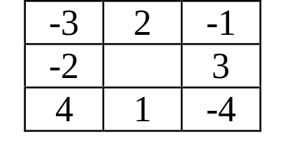
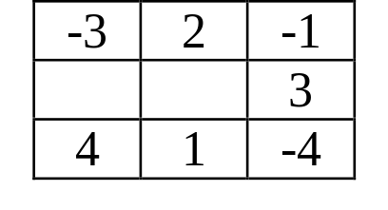
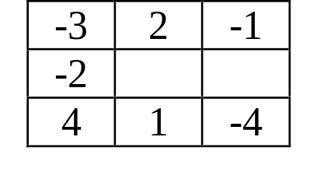

Slide 18

MAX’s Turn
Max
-3
Min
2
-1
Max
1
3
-4
Min
4
-4
1
4
Max
-1
3
2

Slide 19
Pruning
We can use a branch-and-bound technique to reduce the number of states that must be examined to determine the value of a tree.
We keep track of a lower bound on the value of a maximizing node, and don’t bother evaluating any trees that cannot improve this bound.

Slide 20
Pruning in MinMax
Max
-3
Min
2
-1
Max
1
3
-4
Min
4
-4
1
4
Max
-1
3
2

Slide 21
Pruning Minimizing Nodes
Keep track of an upper bound on the value of a minimizing node.
Don’t bother with any subtrees that cannot improve (lower) the bound.

Slide 22
Minimax with
Alpha-Beta Cutoffs
Alpha is the lower bound on maximizing nodes.
Beta is the upper bound on minimizing nodes.
Both alpha and beta get passed down the tree during the Minimax search.

Slide 23
Usage of Alpha & Beta
At minimizing nodes, we stop evaluating children if we get a child whose value is less than the current lower bound (alpha).
At maximizing nodes, we stop evaluating children as soon as we get a child whose value is greater than the current upper bound (beta).

Slide 24
Alpha & Beta
At the root of the search tree, alpha is set to -∞ and beta is set to +∞.
Maximizing nodes update alpha from the values of children.
Minimizing nodes update beta from the value of children.
If alpha > beta, stop evaluating children.

Slide 25
Movement of Alpha and Beta
Each node passes the current value of alpha and beta to each child node evaluated.
Children nodes update their copy of alpha and beta, but do not pass alpha or beta back up the tree.
Minimizing nodes return beta as the value of the node.
Maximizing nodes return alpha as the value of the node.

Slide 26
A
B
C
D
E
F
G
H
3
5
4
I
J
M
N
5
7
8
K
L
0
7

Slide 27
The Effectiveness of Alpha-Beta
The effectiveness depends on the order in which children are visited.
In the best case, the effective branching factor will be reduced from b to sqrt(b).
In an average case (random values of leaves) the branching factor is reduced to b/logb.

Slide 28
The Horizon Effect
Using a fixed depth search can lead to the following:
  A bad event is inevitable.
  The event is postponed by selecting only those moves in which the event is not visible (it is over the horizon).
  Extending the depth only moves the horizon, it doesn’t eliminate the problem.

Slide 29
Quiescence
Using a fixed depth search can lead to other problems:
  it’s not fair to evaluate a board in the middle of an exchange of Chess pieces.
  What if we choose an odd number for the search depth on the game of MinMax?
The evaluation function should only be applied to states that are quiescent (relatively stable).

Slide 30
Pattern-Directed Play
Encode a bunch of patterns and some information that indicates what move should be selected if the game state ever matches the pattern.
Book play: often used in Chess programs for the beginning and ending of games.

Slide 31
Iterative Deepening
Many games have time constraints.
It is hard to estimate how long the search to a fixed depth will take (due to pruning).
Ideally we would like to provide the best answer we can, knowing that time could run out at any point in the search.
One solution is to evaluate the choices with increasing depths.

Slide 32
Iterative Deepening
There is lots of repetition!
The repeated computation is small compared to the new computation.
Example: branching factor 10
  depth 3: 1,000 leaf nodes
  depth 4: 10,000 leaf nodes
  depth 5: 100,000 leaf nodes

Slide 33
A* Iterative Deepening
Iterative deepening can also be used with A*.
1. Set THRESHOLD to be f(start_state).
2. Depth-first search, don’t explore any nodes whose f value is greater than THRESHOLD.
3. If no solution is found, increase THRESHOLD and go back to step 2.

